Slide 1
Nuclear Energy

Slide 2
Nuclear Power
Lecture Questions
  Why nuclear power? What is it used for? What are its main advantages over other forms of energy?
  How important is nuclear power for the production of electricity? How much electricity, worldwide, is produced by nuclear power plants?

Slide 3
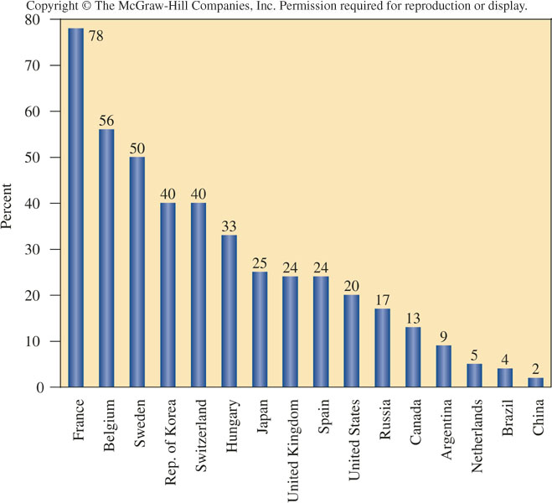
Electricity from Nuclear Power Plants
Globally, 16-17% electricity is produced from nuclear fission.

Slide 4
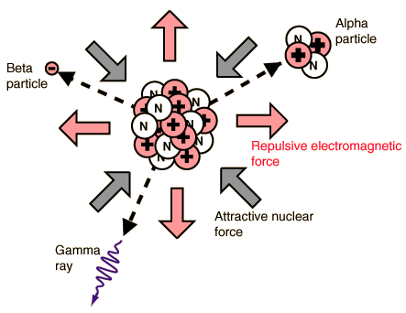
Nuclear Radiation
Lecture Questions
  What is nuclear radiation (ie, “radioactivity”)?
  How is it emitted?

Slide 5
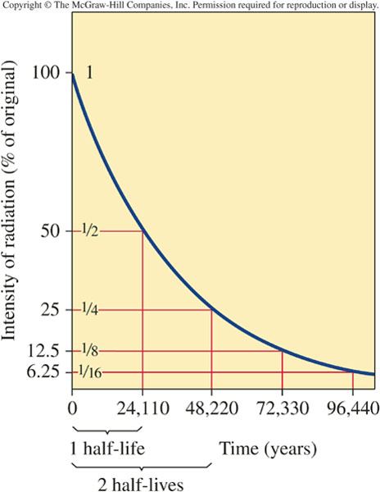

Decay of Radioactive Isotopes
Some atomic nuclei are inherently unstable; they decay to other nuclei (other elements) while emitting radiation
These radioactive nuclei are called radionuclides or radioisotopes.
Radiation is emitted as a rate unique to each isotope
  Characterized by the half-life or natural lifetime
  This rate cannot be changed by any chemical transformation

Slide 6
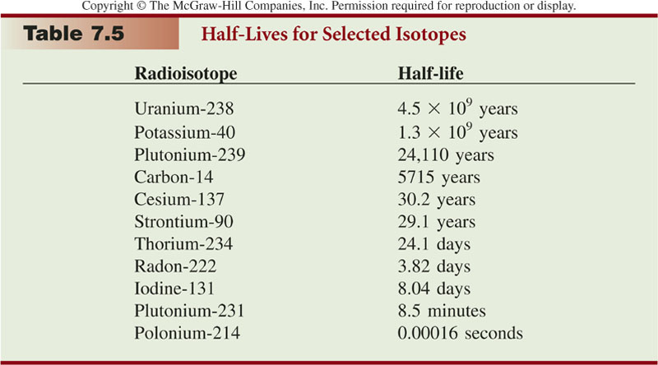
Half-Lives of Some Radioisotopes

Slide 7
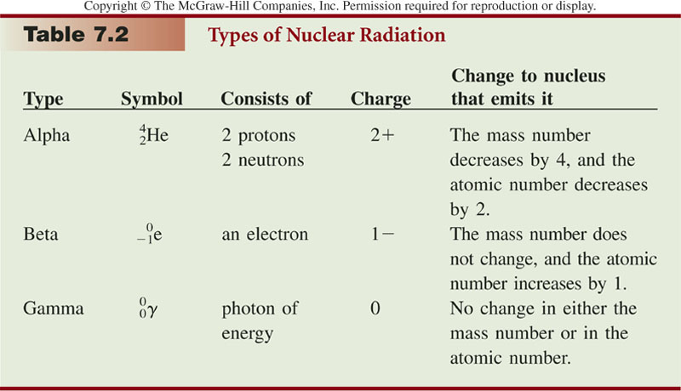
Types of Nuclear Radiation

Slide 8
Uranium-238 Decay Series
Lecture Question
  What is the uranium decay series?

Slide 9
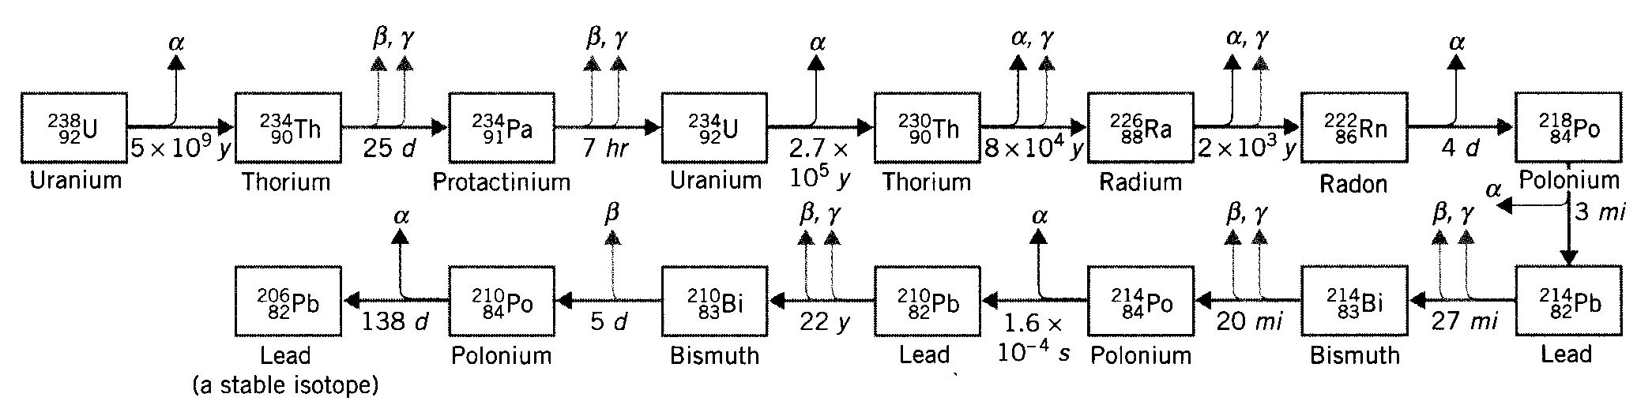
Uranium-238 Decay Series
Uranium
  Most common isotope is uranium-238
    Class exercise: write the symbol for U-238
  Note
    U-235 (NOT U-238) is the fuel for most nuclear power plants worldwide
  U-238 decomposes via a series of spontaneous nuclear reactions
    Ultimate product is lead-206
    Produces a series of radioactive intermediates in its decay series
    One of them is famous: radon-222

Slide 10
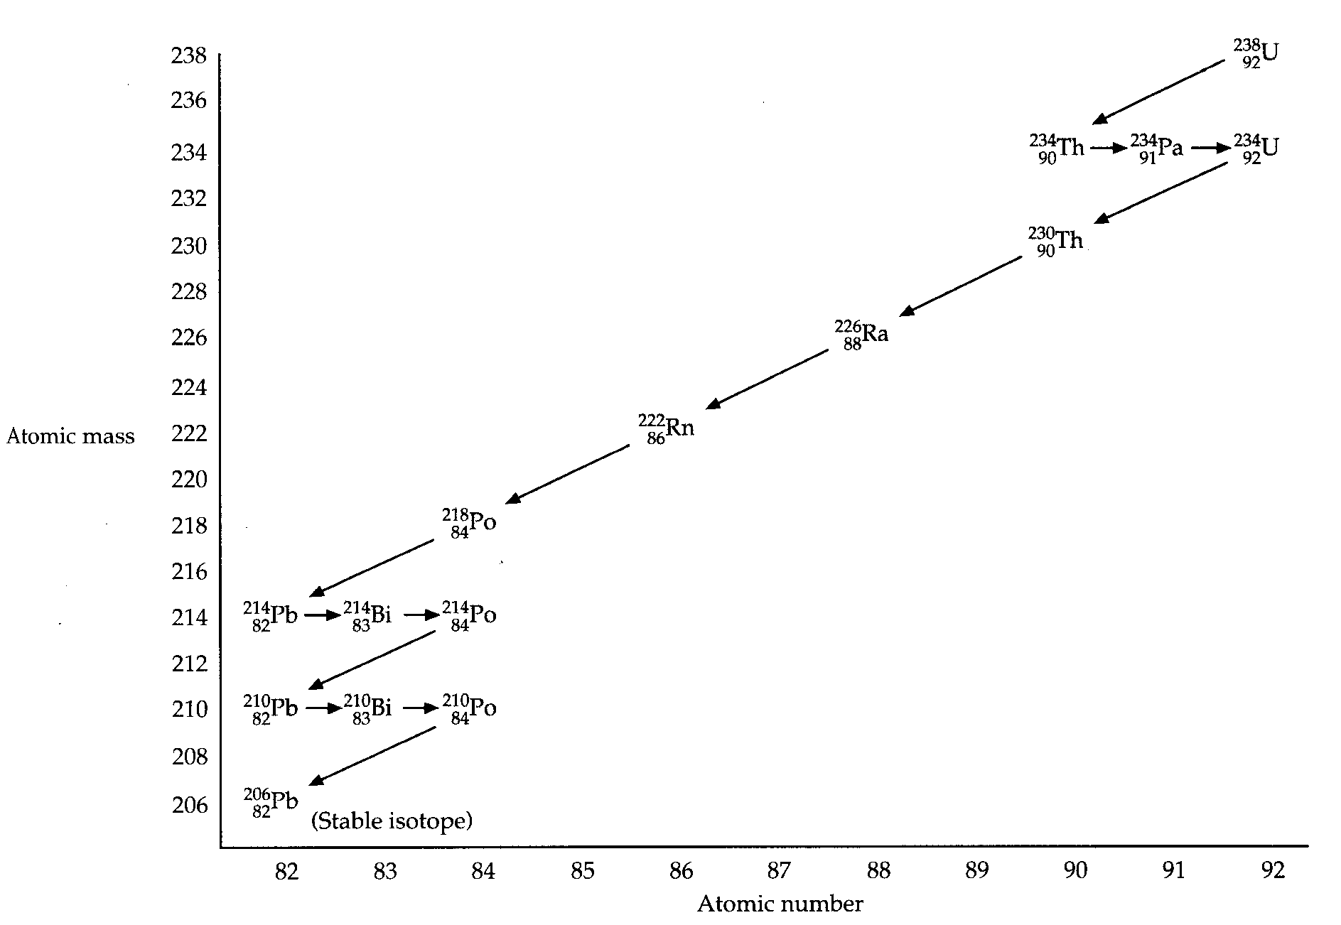
Uranium-238 Decay Series

Slide 11
Stability of Atomic Nuclei
Lecture Question
  Why are some nuclei radioactive? What factor(s) govern(s) nuclear stability?

Slide 12
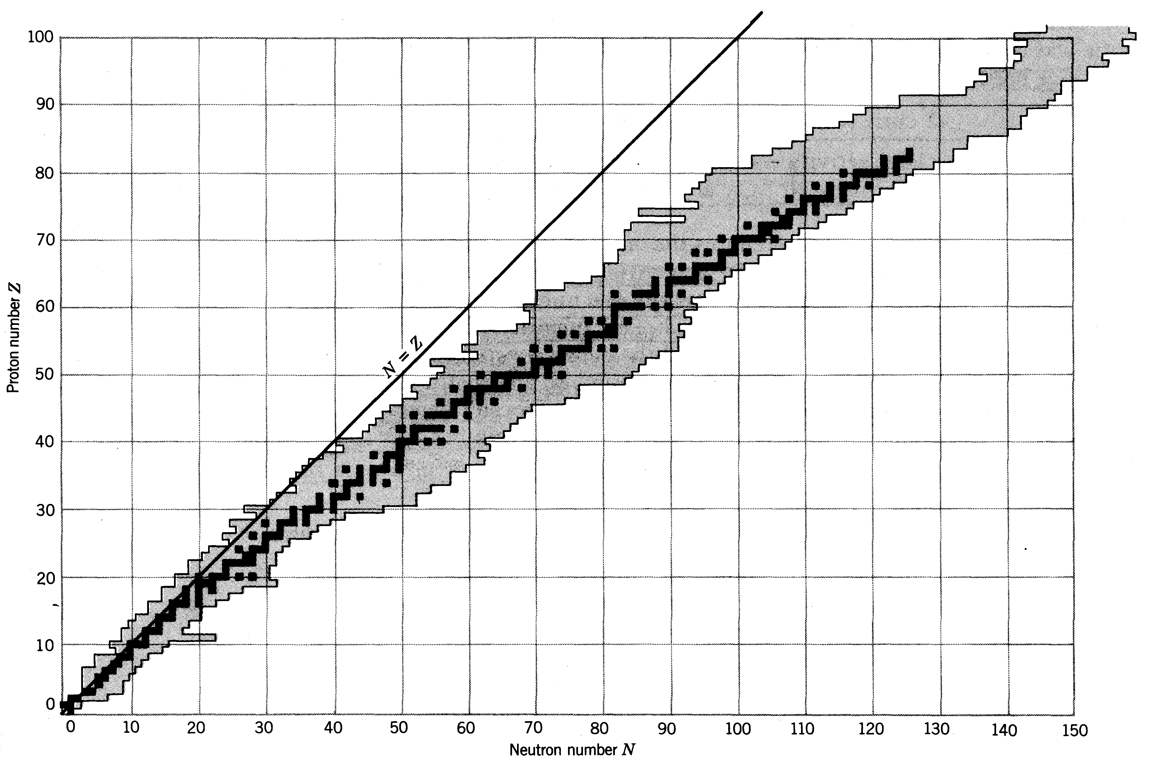
Region of Nuclear Stability

Slide 13
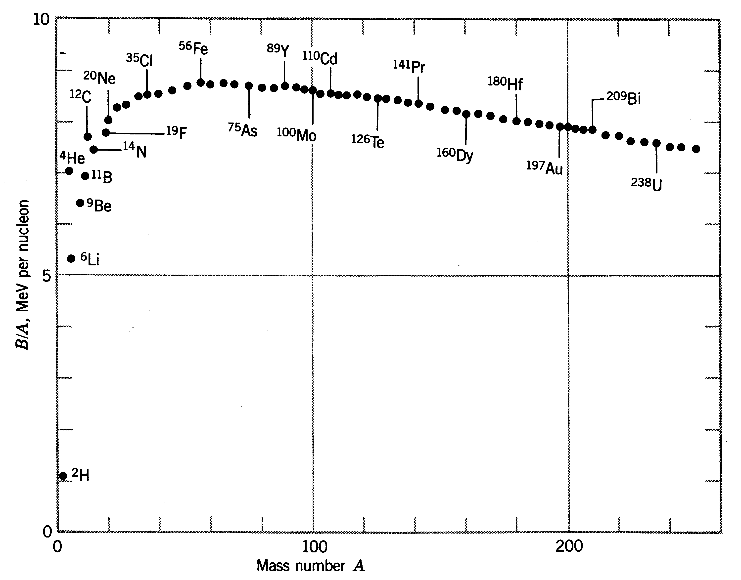
Nuclear Binding Energies of Stable Nuclei

Slide 14
Nuclear Power
Lecture Question
  There is a lot a power contained in an atomic nucleus. But natural radioactive decay – such as alpha and beta decay – is not controllable. So how do can we harness nuclear energy in a controllable fashion?
  Answer: Neutron-induced nuclear fission, such as the following rxn:
  Key: control the concentration and energy of neutrons that induce the reaction!
  Lots of excess energy carried away by the neutron products
    This energy can be used to create steam, electricity, etc
  Fission products are radioactive
    Other products are possible, too.
  Exercise: write a balanced equation for the neutron-activated fission of U-235 to produce Te-137 and Zr-97. How many neutrons are produced?

Slide 15
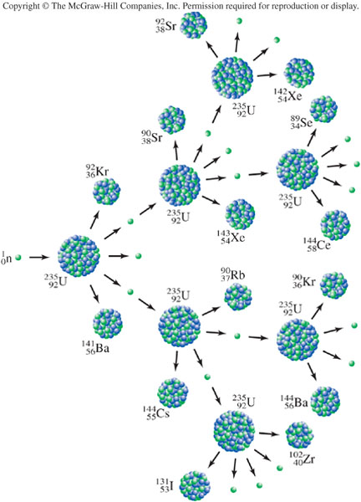
Nuclear Chain Reactions
Chain reaction
  Neutron products induce further fission rxns
  Daughter reactions produce still more neutrons that can induce reactions, etc
Generation ratio
  Defined as the fraction of neutron products that can induce a further (neutron-producing) fission rxn
  Needs to be controlled at exactly 1.00000 (etc)
    Too small: rxn is rapidly quenched
    Too large: boom! (It “goes critical”)
How is the generation ratio controlled? Wait and see…

Slide 16
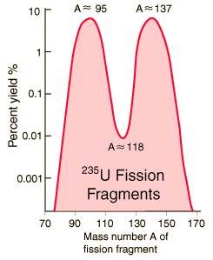
Distribution of Fission Fragments

Slide 17
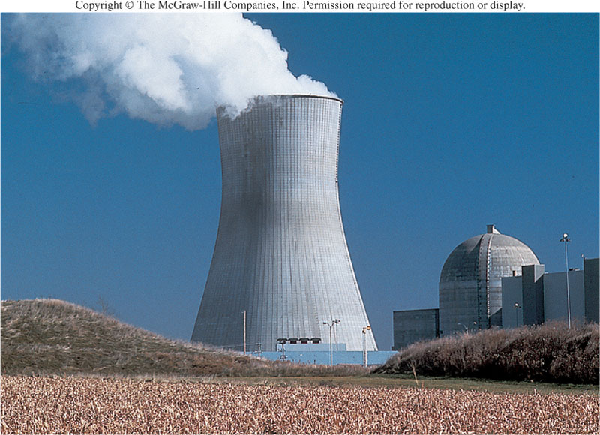
Nuclear Power Plants

Slide 18
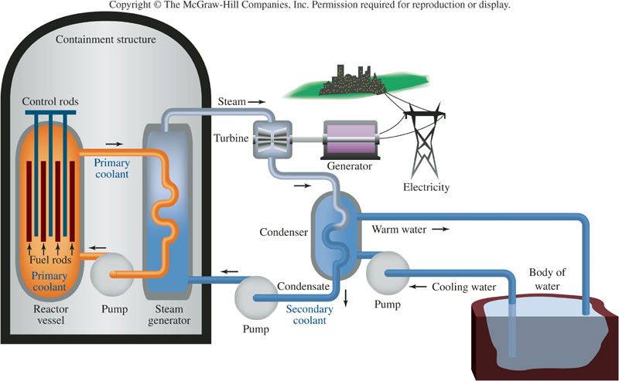
Nuclear Power Plants

Slide 19
Elements in the Nuclear Reactor
Fuel Rods
  Contain the fissionable material
    Also contain a built-in neutron source as initiator
    Usually Be-9 is used; alpha particles cause neutron release
  Eventually are “spent” and must be removed
    Handling and long-term storage is the biggest safety/environmental problem with nuclear fission. Hasn’t been solved to everyone’s satisfaction.
  Material: uranium oxide (usually “enriched” with U-235)
Control Rods
  Absorb all the neutrons
    Cadmium, silver, indium rods all used
  Used to control power output
    Or for emergency shutdown
Moderator (Primary Coolant)
  Usually an aqueous solution of boric acid
Secondary Coolant
  Powers the steam generator (ie, the heat engine)

Slide 20
The Moderator
What does it do?
  Absorbs energy from the “fast” neutrons
    The moderator heats up
    The neutrons become “thermal” neutrons
  Two roles
    Controls neutron energy
    Transfer energy to secondary coolant
  Temperature feedback controls generation ratio
    Energy of neutrons affects generation ratio
      Less energy = more effective at causing fission reactions
    Negative feedback mechanism: as temperature increases
      Neutron energy increases
      Generation ratio decreases
    Ultimately generation ratio “magically” settles to exactly 1

Slide 21
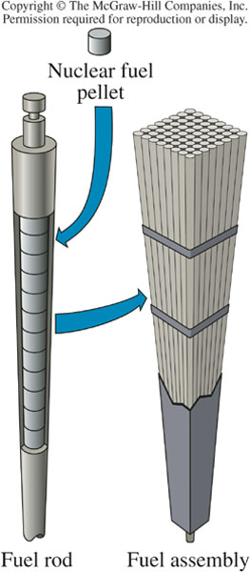
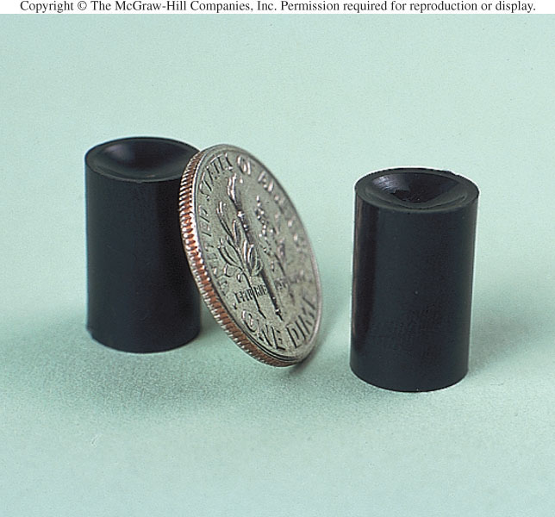
Nuclear Fuel

Slide 22
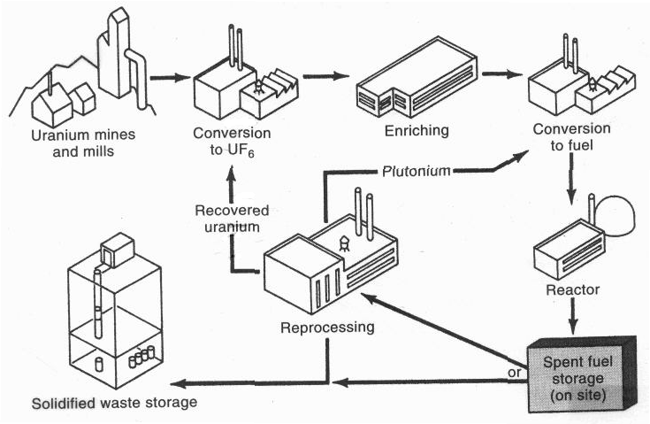
Nuclear Fuel Cycle

Slide 23
Thermal Reactor Designs
Light-Water Reactors (LWRs)
  Used in the US
  Two variants:
    Boiling-water reactors (bwrs) where steam circulates
      Steam produced by the nuclear reactor turns the turbine
      Uses one fewer heat exchangers
    Pressurized-water reactors (pwrs) where pressurized superheated water cirulates
      Probably the most common type world-wide
      3-mile island is a PWR
Heavy-Water Reactors (HWRs)
  Uses deuterated water (D₂O) – “heavy” water – as the moderator
  Used in Canada
  Fuel enrichment is not necessary

Slide 24
Fast Reactors
Fast vs Thermal Reactors
  HWR and LWR designs are all “thermal” reactors
    “Thermal” neutrons are used to sustain fission
  Fast reactors
    Do not need moderators
    Uranium fuel must be highly-enriched – perhaps even weapon’s grade
      Because of lower efficiency
      Also because U-238 readily absorbs fast neutrons
    Plutonium can also be used
Fast Breeder Reactors (FBRs)
  Produces more fissionable fuel than it consumes!
  Once thought to be the future of nuclear power. BUT
    More plentiful supplies of uranium ore were found
    FBRs generally pose a greater security threat

Slide 25
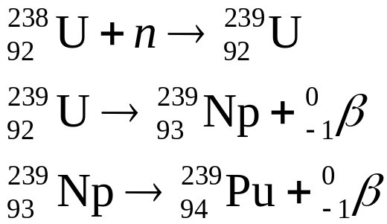
Breeder Reactors
Idea
  Fast neutron capture by U-238 produces fissionable Pu-239
  Pu-239 undergoes neutron-activated nuclear fission to continue producing energy
  Breeder reactors are designed to maximize amount of Pu-239 production
  Amplifies reserves (but not inexhaustible)
    Up to 60% of the energy content of the uranium can be used, instead of 1-2%

Slide 26
Again, the Nuclear Fuel Cycle

Slide 27
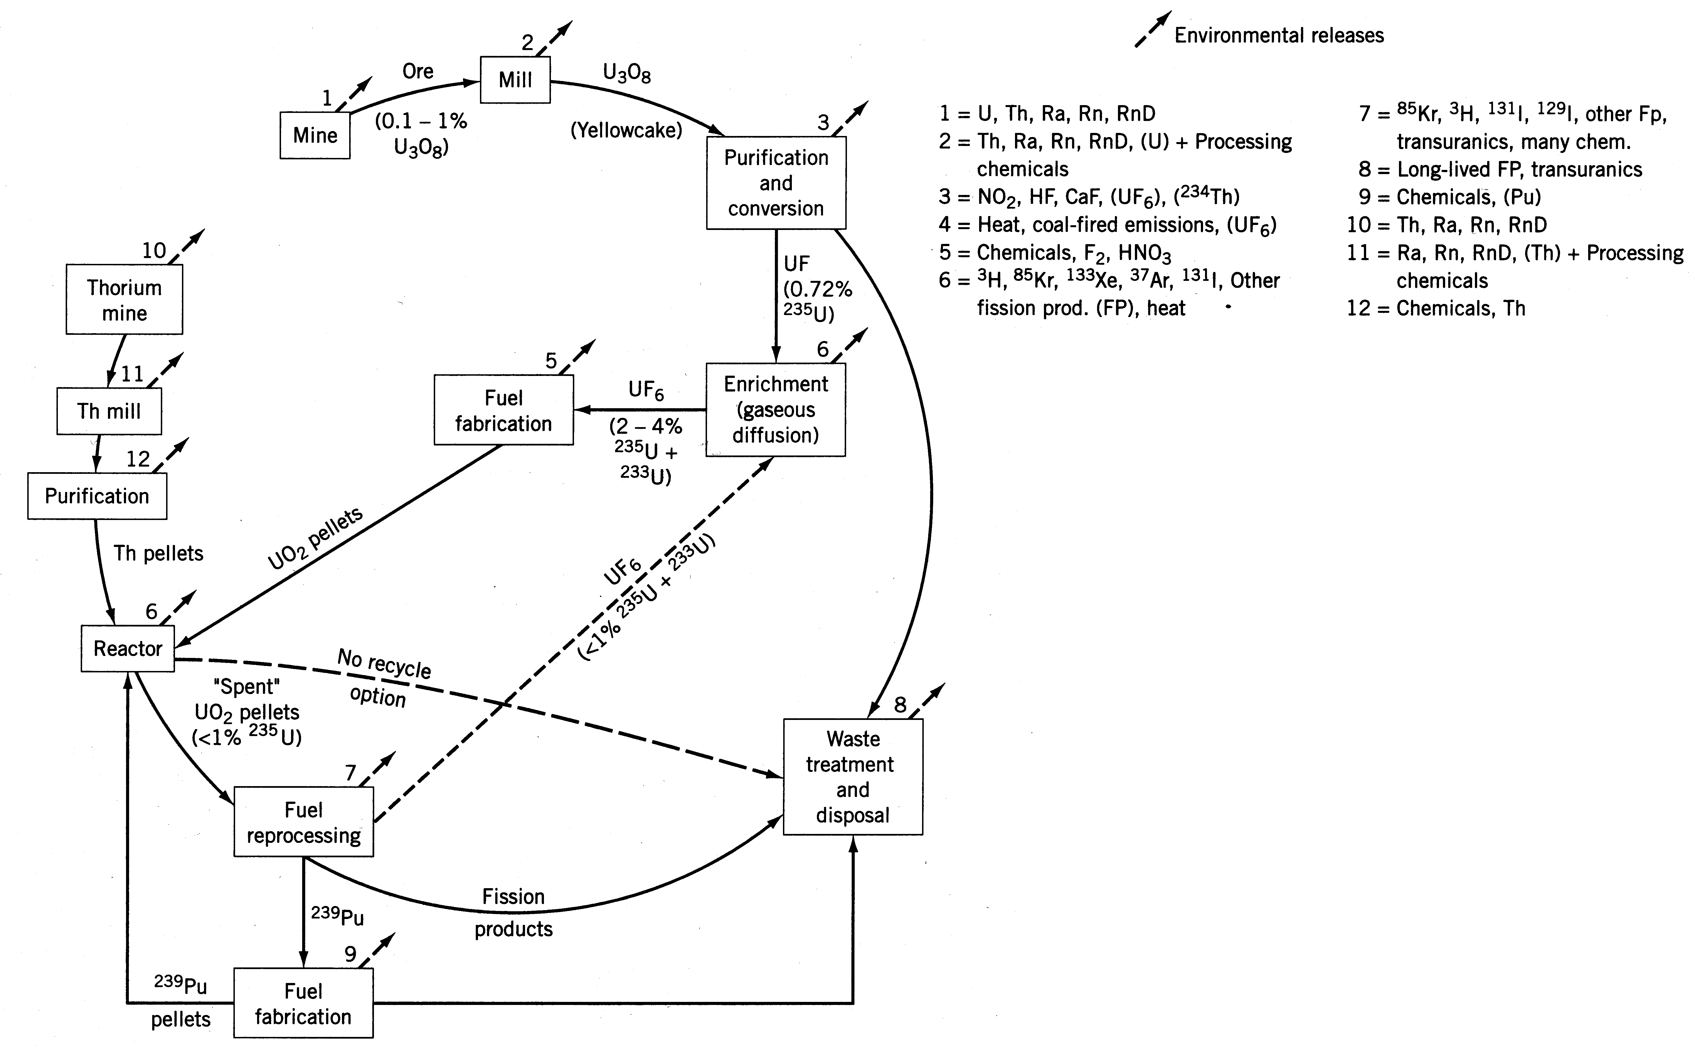
Pollution during the Nuclear Fuel Cycle

Slide 28
Spent Nuclear Fuel
Fission Products
  Lighter isotopes resulting from fission of U-235
    Many are radioactive
  Some fission products of concern
    Strontium-90 (28.8y half-life) and cesium-137 (30y half-life)
      Intermediate half-life means they are pretty radioactive but they are problems for over a century
      Sr-90 the most dangerous part of nuclear fallout; mimics calcium (incorporated in bones, not excreted as readily as Cs-137)
    Iodine-131 (8d half-life)
      Intensely radioactive but short-lived
      Volatile, hence highly mobile in the environment
        Particularly a concern in accidental leaks/spills
Transuranics (Actinides)
  Heavier elements than uranium
    Created by neutron-capture that is not followed by fission
      Most products are both highly toxic and radioactive
    Plutonium (Pu) isotopes a major product
      Many are fissionable
      Can be used to fashion nuclear weapons

Slide 29
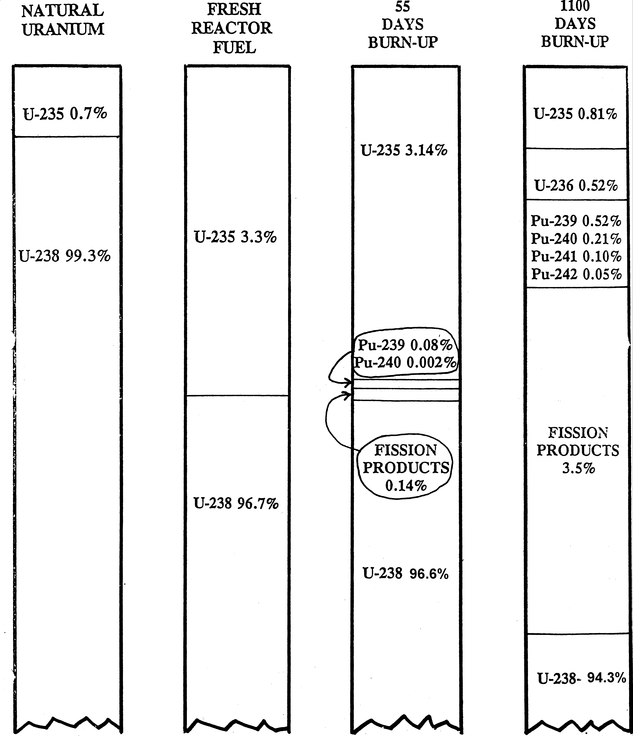
Composition of Nuclear Fuel
Natural uranium ore contains too much U-238 and must be enriched prior to use.
The fuel is “spent” when the U-235 decreases to levels near normal
In the meantime, fission products and transuranics have been produced.
Plutonium and other transuranics are produced through a combination of neutron capture and alpha/beta decay.

Slide 30
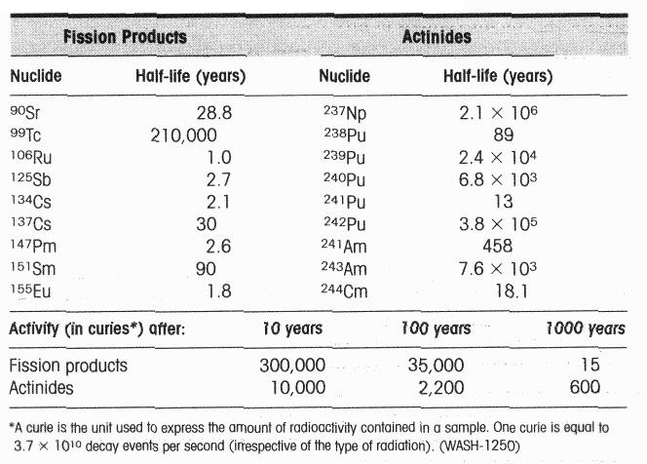
Radioactive Wastes in Spent LWR Fuel

Slide 31
HLW Disposal Options
Lecture Question
  What are the options for disposing of spent nuclear fuel rods?
  Reprocessing and fractionation
  Transmutation
  Disposal in Space
  Ice-Sheet Disposal
  Seabed Disposal
  Geological Disposal
    Deep burial (6 – 10 mi)
    Rock-melting, 1 mi deep. Wastes melt and mix w/ rocks.
    Hydrofracture
    Island isolation
    Mined cavity (eg, Yucca Mt)

Slide 32
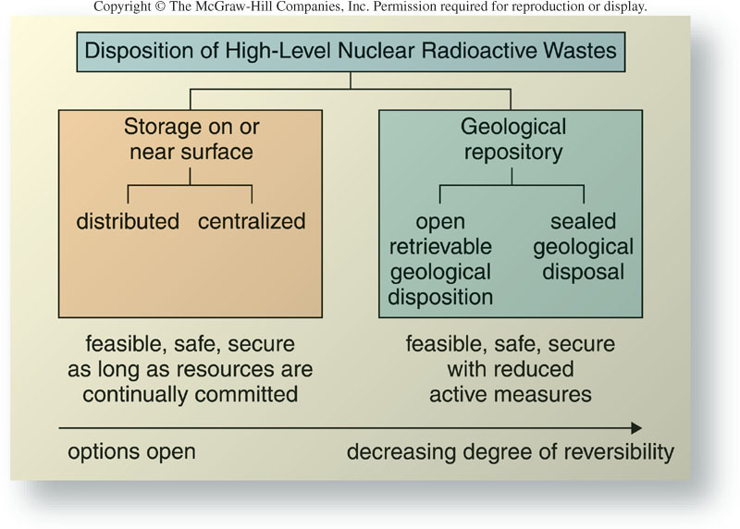
HLW Disposal Options

Slide 33
Radioactive Waste Disposal
Types of radioactive waste
  High-level waste (HLW)
    Radiation levels higher
    Long half-lives
    Require permanent isolation from humans and ecosystems
    Origins: nuclear power plants; nuclear weapons (vast majority)
  Low-level waste (LLW)
    Radioactivity levels much lower
    Origin: laboratories, medical facilities, mining, pharmaceutical industry, military
    Disposal somewhat similar to other types of hazardous (non-radioactive) waste
      Usually sealed in canisters and buried
      Special LLW disposal sites (2 in the US)
1982 Nuclear Waste Policy Act
  Originally designated 3 sites for intensive studies: in Washington, Texas and Nevada
  1987 amendments designated Yucca Mountain (Nevada) as the sole site to be studied as a potential repository of HLW
  July 2002, Senate cast final vote approving Yucca Mt as HLW respository

Slide 34
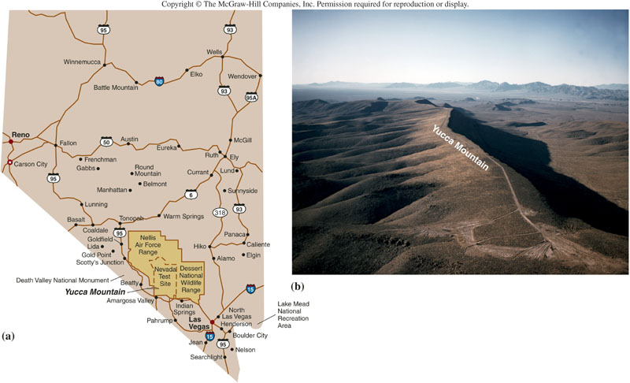
Yucca Mountain

